Slide 1


AUTOMATION ON SELENIUM USING SELENIUM WEBSITE
Banisetti Swathi
201315

Slide 2



Contents:
Introduction
Spring Initializr
Eclipse
Selenium
Github
Jenkins

Slide 3
INTRODUCTION:
Presentation is about the Automating the website using selenium tool
Selenium is an open-source, automated testing tool used to test web applications across multiple browsers.
Selenium is developed by Jason Huggins in 2004.
Selenium supports automation across different browsers, platforms and programming languages.

Slide 4
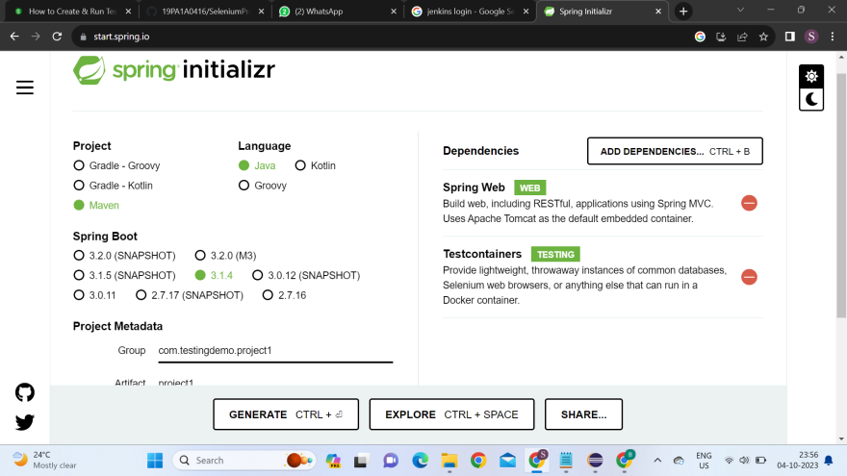
SPRING BOOT INITIALIZR:
Spring Initializr is a Web-based tool that generates the Spring Boot project structure.

Slide 5
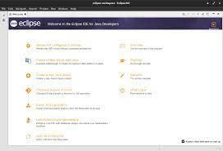
ECLIPSE:
Eclipse is open-source software, which means that it is freely available for anyone to use and modify.
It’s a software developers to create, debug, and maintain software applications.

Slide 6
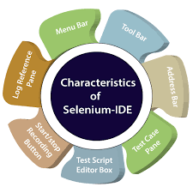
SELENIUM :
Selenium is an open-source, automated testing tool used to test web applications across multiple browsers.
Selenium can be used to automate functional tests.
Selenium supports automation across different browsers, platforms and programming languages.
Integrated with Automation test tools such as Maven,jenkins & docker.

Slide 7
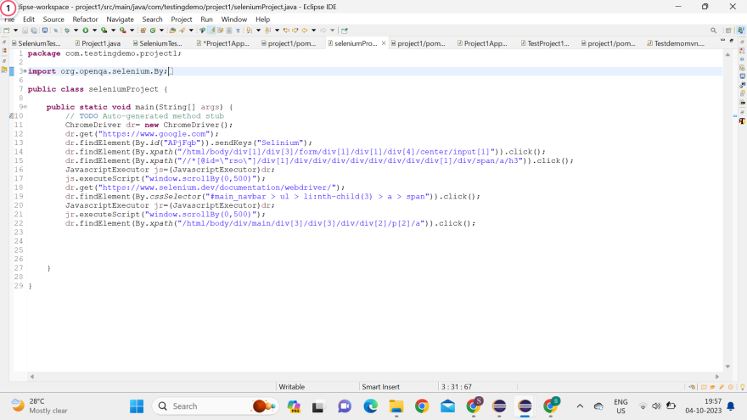
SOURCE CODE:

Slide 8
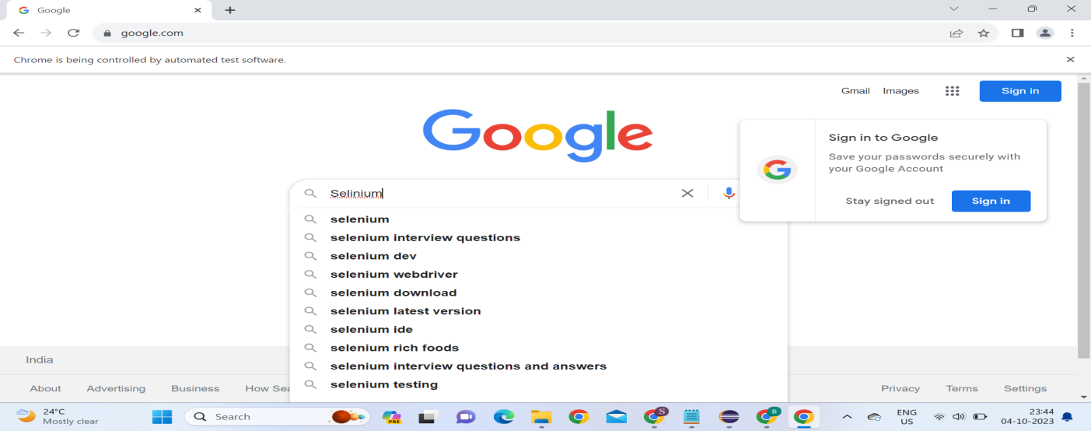
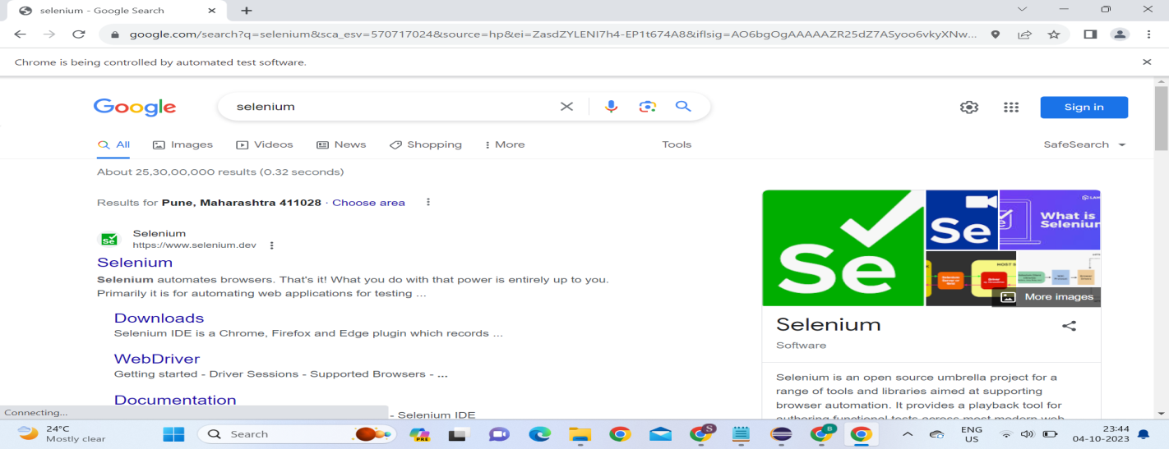
OUTPUT:

Slide 9
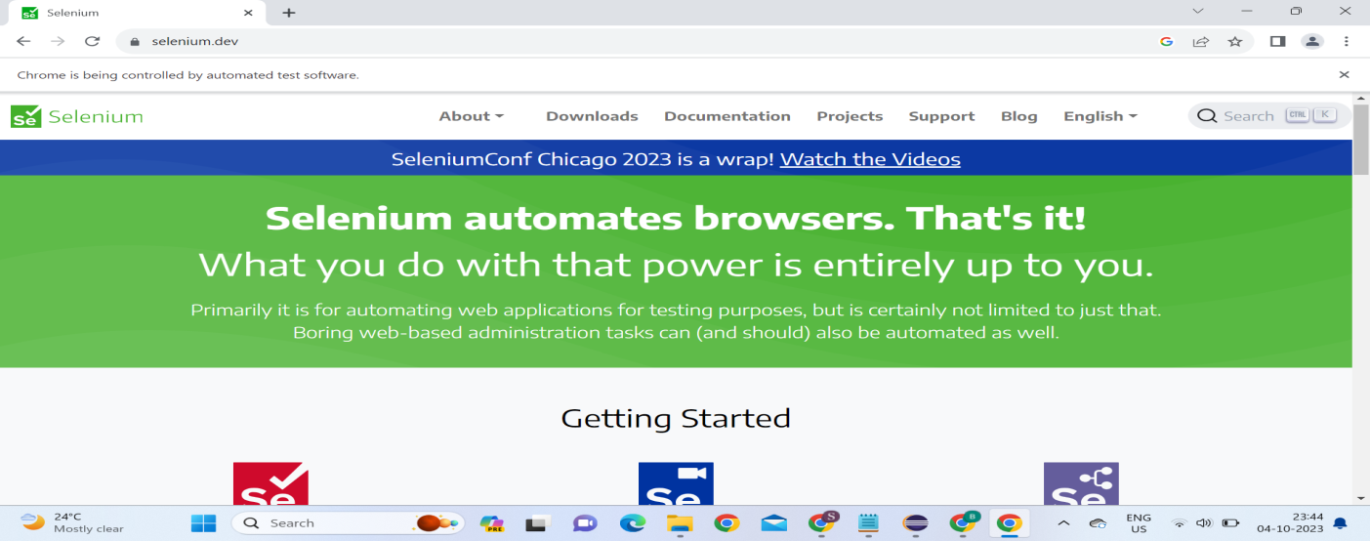
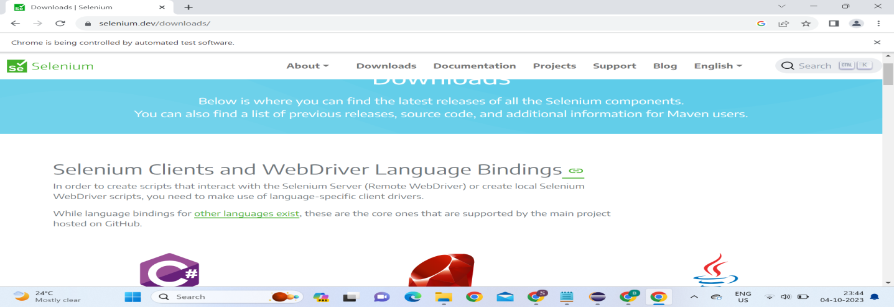
OUTPUT:

Slide 10
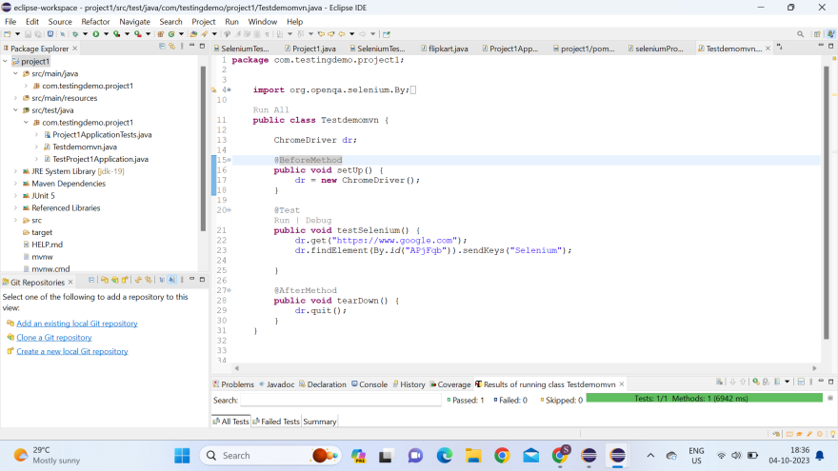
TESTNG RESULTS:
TestNG is one of the most widely used open source testing framework used in automation testing suite.

Slide 11
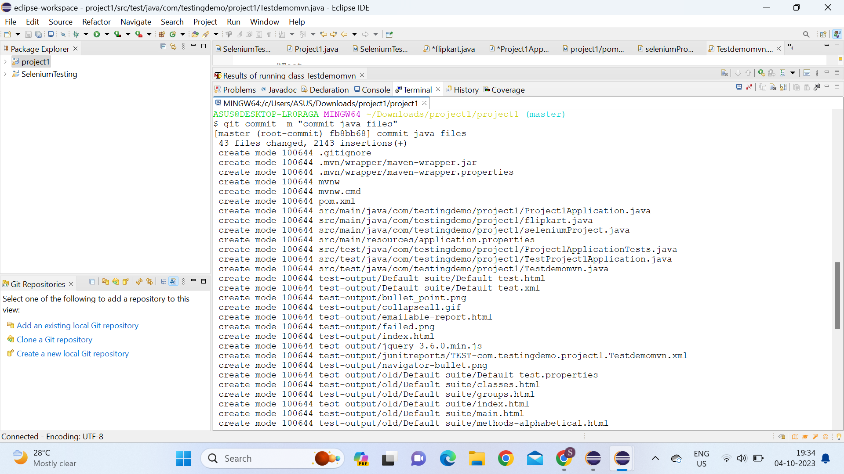
GITHUB:
Tracking code changes
Tracking who made changes
Coding collaboration
After Successfully Execution of code we need to push the code into the github.

Slide 12
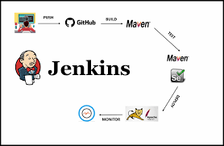
JENKINS:
Jenkins is an open-source automation tool written in Java with plugins built for continuous integration. Jenkins is used to build and test your software projects continuously making it easier for developers to integrate changes to the project, and making it easier for users to obtain a fresh build.

Slide 13
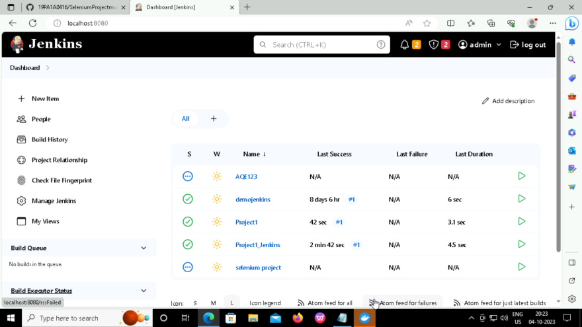
OUTPUT:

Slide 14


